Slide 1

Programming for Engineers
BEP2073
>> Slide 5.1
>> Function, method and class (Part 1)
Functions as a type, anonymous functions and list comprehensions codes.

Slide 2

















Slide 3

Course Learning Outcome
CLO1 | Outline the operational procedure of programming language.
CLO2 | Outline the object-oriented attribute in the programming flow.
CLO3 | Evaluate the program structure on function, branching and condition.
CLO4 | Develop a programming/syntax solution for chemical engineering case study.
CLO5 | Differentiate between solution error and syntax error for complex engineering case study

Slide 4












Exercise 1
Generate random number
Solve $y =7\sin\left(x\right)−3 cos⁡(2x)$

Slide 5
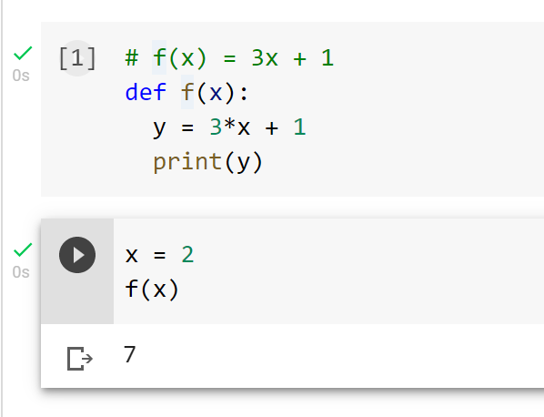



















1. Functions
Built-in function; i.e → max, min, sum, …
User-define function;
def name_of_function (input_arguments):
body of function
def is a reserved word that tells Python that a function is about to be defined.
input_arguments are bound (as in an assignment statement) to the actual parameters.

Slide 6
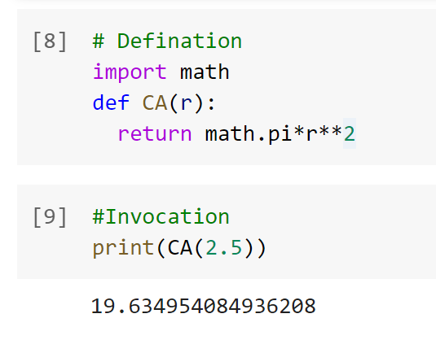
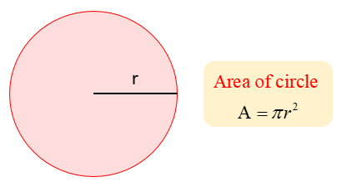




Example 1
Create function to calculate area of a circle for r = 2.5 in.
def CircleArea(r):
pi = 22/7
return pi*r**2
function definition
r = 2.5
Ans = CircleArea(r)
print(Ans)
function invocation
return, that can be used only within the body of a function.

Slide 7
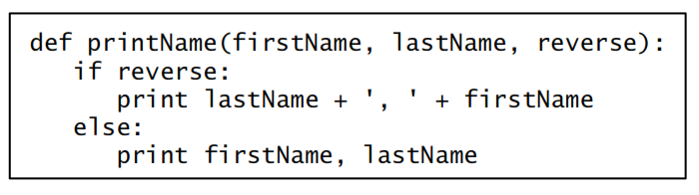
Exercise 2
Create function printName assumes that firstName and lastName are strings and that reverse is a Boolean.

Slide 8
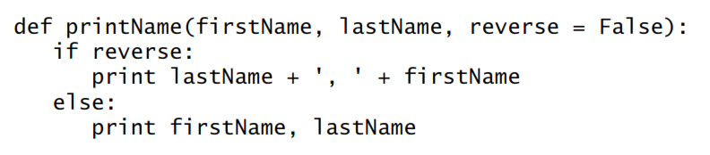





Default Values
Default values allow programmers to call a function with fewer than the specified number of arguments.
printName('Olga', 'Puchmajerova')

Slide 9










Keyword arguments
Input arguments are bound to actuals using the name in the function.
Solve for x = 1 and y =2
$$f(x,y)=2x+3y^{1.5}$$
Ans = f(1,2)
print(Ans)
def f(x,y):
return 2*x+3*y**1.5
Ans = f(y=2,x=1)
print(Ans)

Slide 10


2. Specifications
Comment (text) inside the function
Use to inform the user on the description/guide
Ie
def CircleArea(r):
"""Assumes x is int or float,
Returns float Area such that pi*r**2."""
pi = 22/7
return pi*r**2
help(CircleArea)

Slide 11




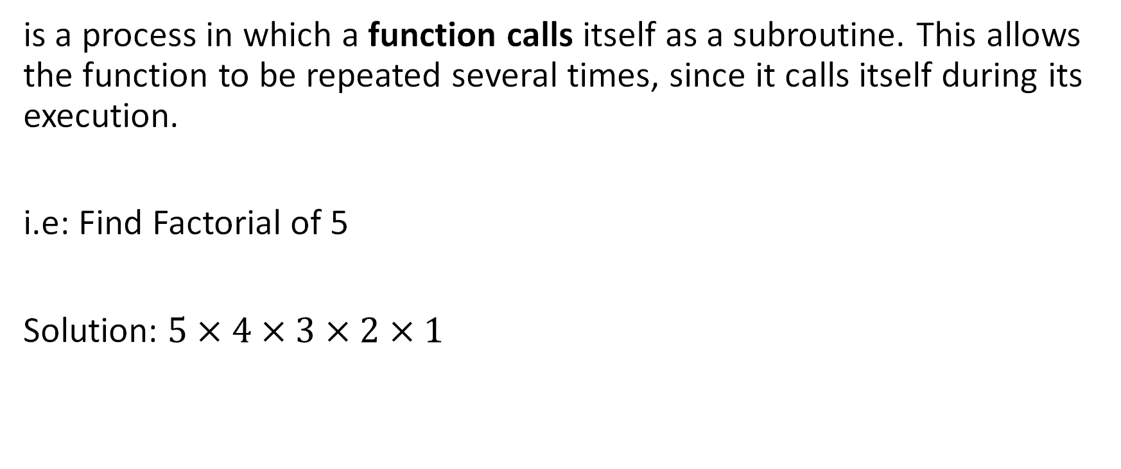

3. Recursion
is a process in which a function calls itself as a subroutine. This allows the function to be repeated several times, since it calls itself during its execution.
i.e: Find Factorial of 5
Solution: $5×4×3×2×1$
  n = 5
  Ans = 1
  while(n>1):
  Ans=Ans*n
  n=n-1
  print(Ans)
  def factorial(n):
  Ans = 1
  while(n>1):
  Ans=Ans*n
  n=n-1
  return Ans
factorial(5)
Iterative approach

Slide 12



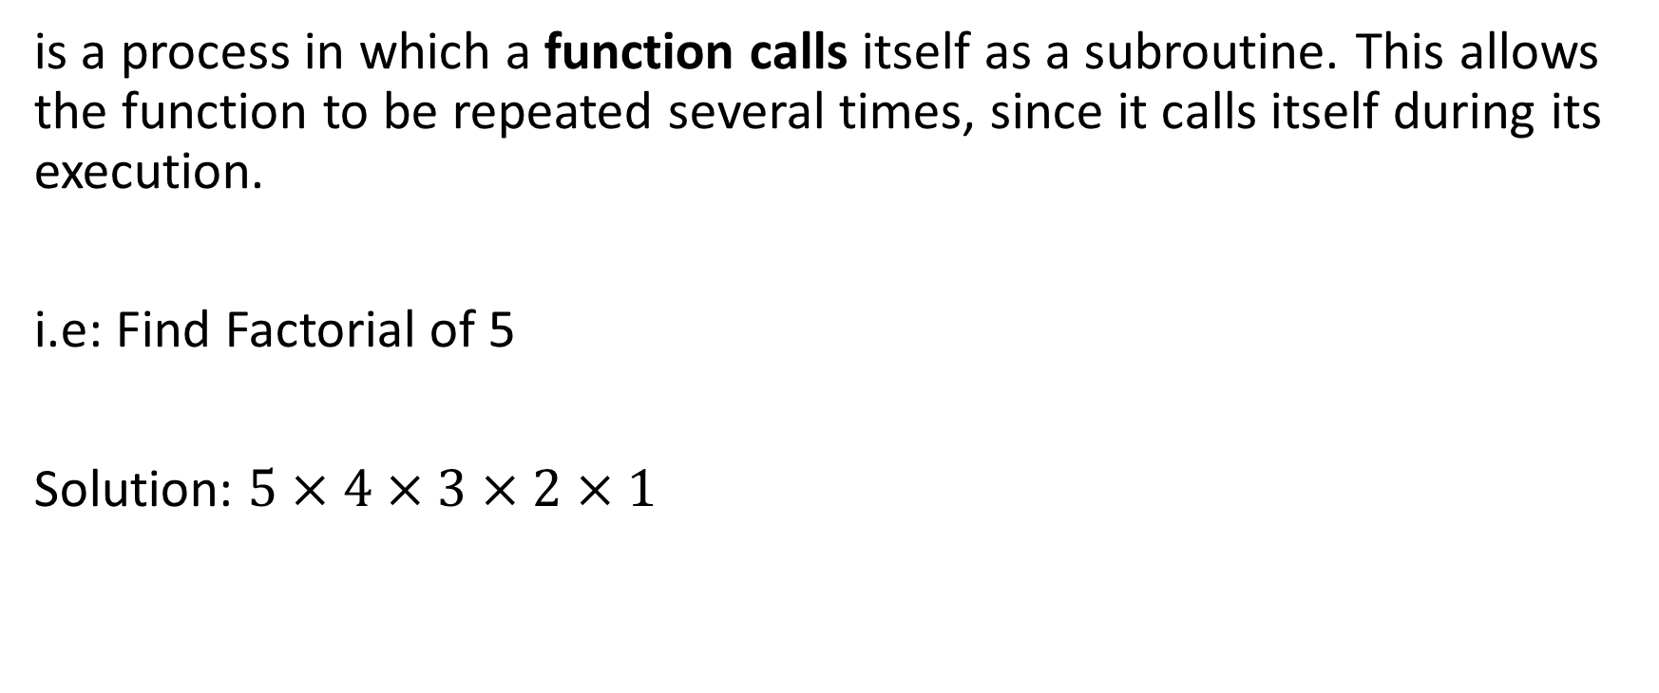

3. Recursion
is a process in which a function calls itself as a subroutine. This allows the function to be repeated several times, since it calls itself during its execution.
i.e: Find Factorial of 5
Solution: $5×4×3×2×1$
  def factorialR(n):
  if n == 1:
  return n
  else:
  return n* factorialR(n-1)
factorialR(5)

Slide 13















4. Global Variables
Variable and function are communicated within their environment.
def CircleArea(r):
pi = 22/7
return pi*r**2
def CylVolume(r,h):
pi = 22/7
return 2*pi*r*h
def CircleArea(r):
global pi
pi = 22/7
return pi*r**2
def CylVolume(r,h):
return 2*pi*r*h

Slide 14
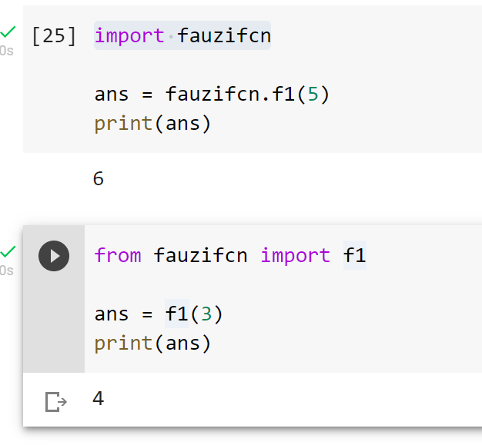
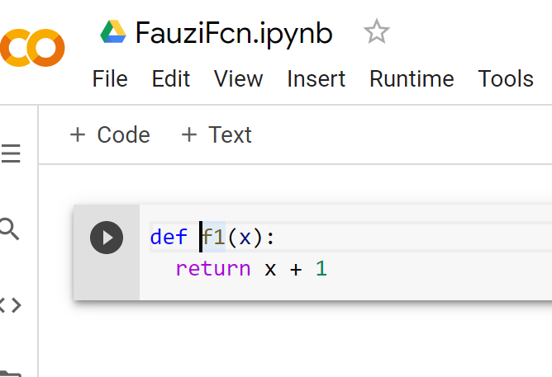





5. Modules
Modules are typically stored in individual files.
Python modules allow us to easily construct a program from code in multiple files.
Module is a .py file containing Python definitions and statements.
Usage: import circle OR from circle import *

Slide 15
Example
Step 1: Create file name Module1.py
Step 2: Create New file
pi = 22/7
def CircleArea(r):
return pi*r**2
  Import Module1
  print(Module1.pi)
  Ans = Module1. CircleArea(2)
  print(Ans)
  Import Module1 as m1
  Print(m1.pi)
  Ans = m1. CircleArea(2)
  print(Ans)
  from Module1 import pi
  print(pi)
  from Module1 import *
  print(pi)
  Ans = CircleArea(2)
  print(Ans)

Slide 16





Exercise
Develop a module to calculate volume for CO₂ gas at certain mass, pressure and temperature. Given: R = 0.08206 L (atm)/K (mol)
Use each of the equation as a function inside the module
  n = m/Mw
  V = nRT/P
By using developed module, compute and display result for CO₂ volume in cases below:
  Case 1: m = 32 g, P = 50 atm, T = 325 K
  Case 2: m = 25 g, P = 70 atm, T = 450 K

Slide 17
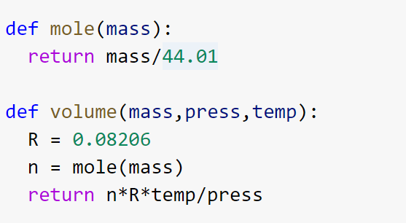
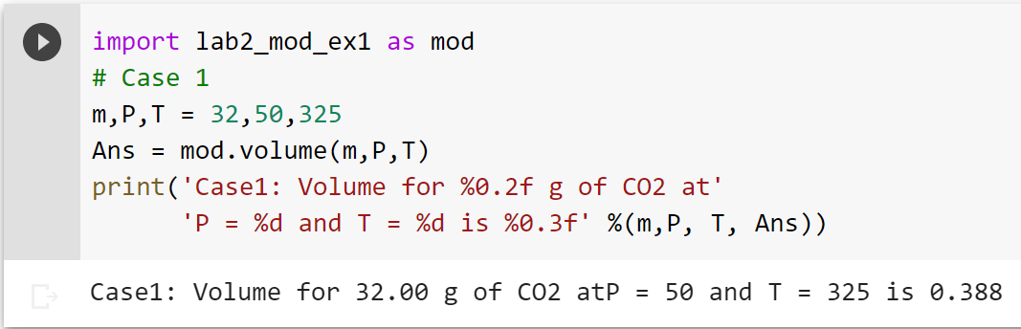
SAVE as lab2_mod_ex1
Create new file and import module

Slide 18











Class
A class is a blueprint for the object.
Example:
HOUSE: floors, doors, windows etc.
Class House:
floors = 2
doors = 10
>> print(House.doors)
[Output]: 10

Slide 19
Creating an Object from Class
This will create a new object instance named c.
Then, we can access the data or method of objects using the object name prefix.
Class Car:
doors = 4
c = Car()
instance
>> a = c.doors

Slide 20












Constructors in Python
__init__() function is special function that gets called whenever a new object of that class is instantiated.
This type of function is also called constructors.
class ComplexNumber:
def __init__(self, r = 0, i = 0):
self.real = r
self.imag = i
def get_data(self):
print(str(self.real) + str(self.imag)+'j')
num1 = ComplexNumber(2, 3)
num1.get_data()
[Output]: 2+3j

Slide 21
Example: Create Student List
Using class approach, create an application to store student name.
class Student():
def __init__(self):
self.StudentList = []
def addStudent(self,name):
self. StudentList.append(name)
Obj = Student()
Obj.addStudent(‘FAUZI’)
Hint: Make application for user data entry by Create main menu for
Data Entry

Slide 22


Solution framework
START
DEFINE ListName as empty
while TRUE
false
true
DISPLAY menu
  1- Data Entry
  2 - Exit
User INPUT as Opt
1
Opt == 1
false
Opt == 2
false
true
true
ADD student name MODULE
BREAK
DISPLAY wrong selection
END
1

Slide 23
EXCEPTIONS
An “exception” is usually defined as “something that does not conform to the norm,” and is therefore somewhat rare.
Example
  test = [1,2,3]
  test[3]
List of exception: IndexError, ValueError, ZeroDivisionError, and more.
  Ref: https://www.programiz.com/python-programming/exceptions
Control Flow Mechanism: raise exceptionName(arguments)

Slide 24
TRY-EXCEPT
This code will work just fine, but it will fail if numFailures happens to be zero.
It would have been better to have try-except
x = 1
y = 2
ratio = x/y
Print(ratio)
try:
ratio = x/y
print('The ratio is’ + str(ratio))
except ZeroDivisionError as e:
print(‘Error: ’,e)

Slide 25

Answer on the following
Case study 1: Using class approach, create an application to store student name.
class Student():
def __init__(self):
self.StudentList = []
def addStudent(self,name):
self. StudentList.append(name)
# display student from list
???
# remove student from list
???
Obj = Student()
Obj.addStudent(‘FAUZI’)
Obj. getStudentList
Challenges:
1. Make application for user data entry
2. Create main menu for
  Data Entry
  Data removal (Hint: pop() or remove())
  Data Display (Option: Pandas)
3.How to avoid error during execution (Hint: Exception)
Final Solution - reflect! How could you improve it? Test it!

Slide 26
End

